Slide 1
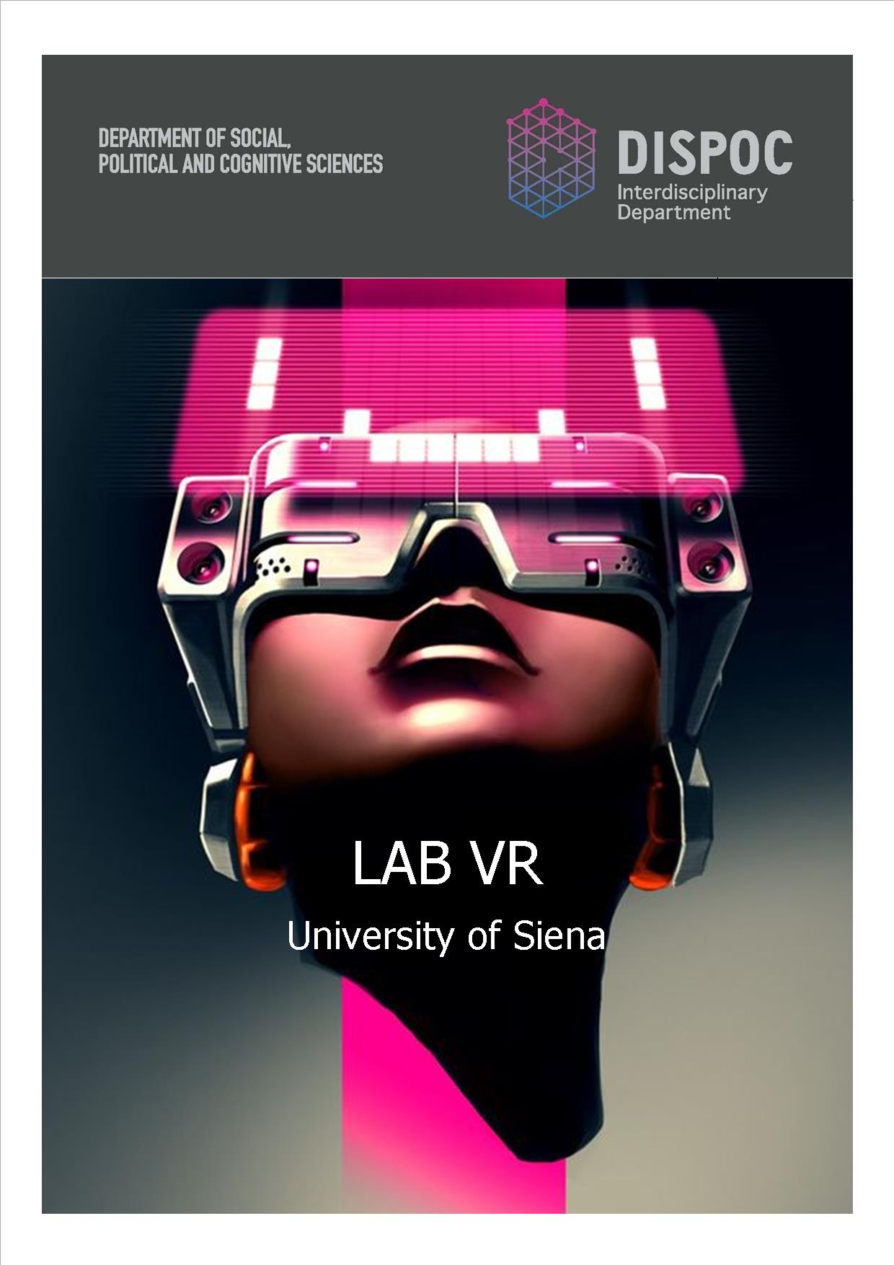
Workshop
Cognition, rationality, and pro-social behavior
Virtual Reality Experiments in Economics
Alessandro Innocenti
University of Siena
IMT School for Advanced Studies, Lucca
March 22, 2019

Slide 2
Talk Purpose
To address the question of whether behavior in virtual environments is a valuable source of empirical evidence for economists.
To propose the distinction between low-immersive (LIVE) and high-immersive virtual environments (HIVE)
To argue that virtual reality experiments are framed field experiments, which allow testing the effect of contextual cues on economic behavior
To explore the potentialities of virtual reality experiments in economics

Slide 3
Talk Outline
The Context-Free Bias
Low and High Immersive Virtual Environments
LIVE Applications
What future? A modest approach

Slide 4
Weaknesses of lab experiments
a) experimental situations are not really presented, but only described through language
b) choices and decisions are only evoked, not really performed
c) there is lack in the normal cascade of events as actions and reactions
d) temporal frame is compressed
e) irrelevance of the context

Slide 5
Lab as silicon chip production
Many experimental economists seem to view their enterprise as akin to silicon chip production. Subjects are removed from all familiar contextual cues. Like the characters 'thing one' and 'thing two' in Dr. Suess' Cat in the Hat, buyers and sellers become 'persons A and B', and all other information that might make the situation familiar and provide a clue about how to behave is removed.
      George Loewenstein (1999)

Slide 6
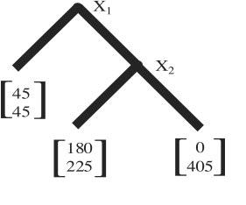
Trust Game
McCabe et al. (2001)

Slide 7
1. The context-free bias
The context-free experiment is an elusive goal
A major tenet of cognitive psychology is how all forms of thinking and problem solving are context-dependent
The laboratory is not a socially neutral context, but is itself an institution with its own formal or informal, explicit or tacit, rules
Games in the laboratory are usually played without labels but subjects inevitably apply their own labels

Slide 8
Methodological Biases
The key assumptions of experimental economics is that the use of non-professional subjects and monetary incentives allows making subjects’ innate characteristics largely irrelevant
In some experiments, it is as if subjects take into the lab the preferences applied to real choices and stick to them with high probability
These biases or inclinations tend to override the incentive effect
Labels may give subjects clues to become less and not more rational

Slide 9
The power of labels
Labels increase experiments’ external validity with a minimal sacrifice of internal validity
In particular, to test learning and cognitive models, it is necessary to remind and to evoke contexts which may activate emotions, association, similarities in the laboratory
Labels can make subjects more or less rational in relation to the evoked contexts.

Slide 10
Providing clues
One of the basic tenets of laboratory methodology in experimental economics is that the use of non-professional subjects and monetary incentives allows making subjects’ innate characteristics largely irrelevant (representative agent)
But laboratory research should highlight subjects’ preferences when applied to real choices
In these experiments labels give subjects clues that make them immerse in a context

Slide 11
Which virtual reality?
VR offers us a way to simulate reality. We do not say that it is “exactly as real” as physical reality but that VR best operates in the space that is just below what might be called the “reality horizon.”
Slater and Sanchez-Vives (2016) p. 2
OR
VR is a difficult task – since it encompasses what can be done in physical reality (for good or evil). But even more, since it is VR, we emphasize that we can break out of the bounds of reality and accomplish things that cannot be done in physical reality. Herein lies its real power.
Slater and Sanchez-Vives (2016) p. 3

Slide 12
Synthetic field cues
The use of presentations with virtual reality simulations can convey this kind of context
“A Virtual Experiment is an experiment set in a controlled lab-like environment, using typical lab or field participants, that generates synthetic field cues using Virtual Reality (VR) technology.”
Fiore et al. (2009)
Virtual experiments can also occurred over the web: Virtual Worlds experiments as a subset of Virtual Reality Experiments

Slide 13
2. Low and High Immersive Virtual Environments
Low-Immersive Virtual Experiments (LIVE)
use computer screen based applications of virtual reality, such as “ad hoc” virtual simulations or virtual worlds (Second Life), to provide a weaker sense of presence
High-Immersive Virtual Experiments (HIVE)
utilize specialized displays such as CAVE, head-mounted displays or augmented reality, which perceptually surround subjects. The individual perceives himself to be enveloped by, included in, and interacting with an environment providing a continuous stream of stimuli.

Slide 14
VR/AR Tools
Augmented Reality
Virtual simulation
Virtual worlds
Oculus VR
HTC Vive
CAVE Automatic Virtual Environment

Slide 15
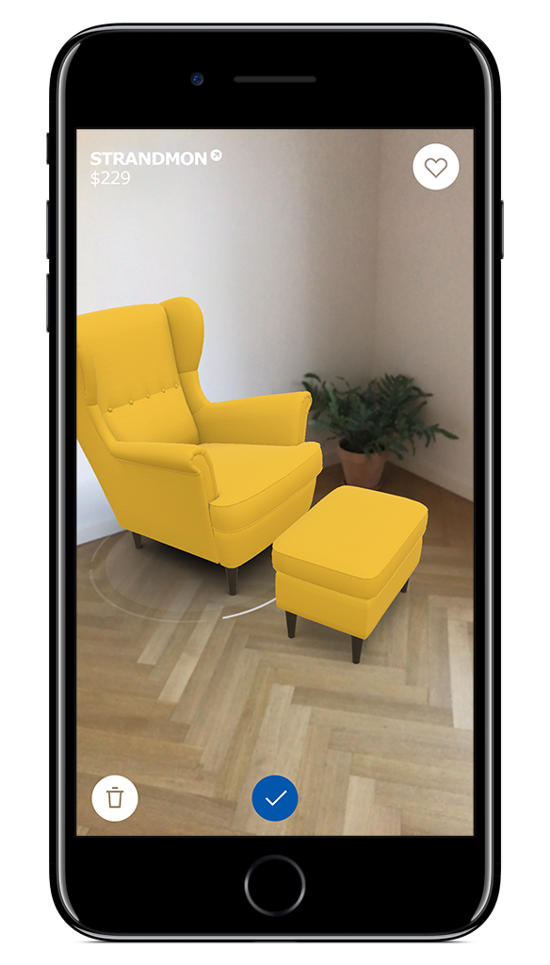
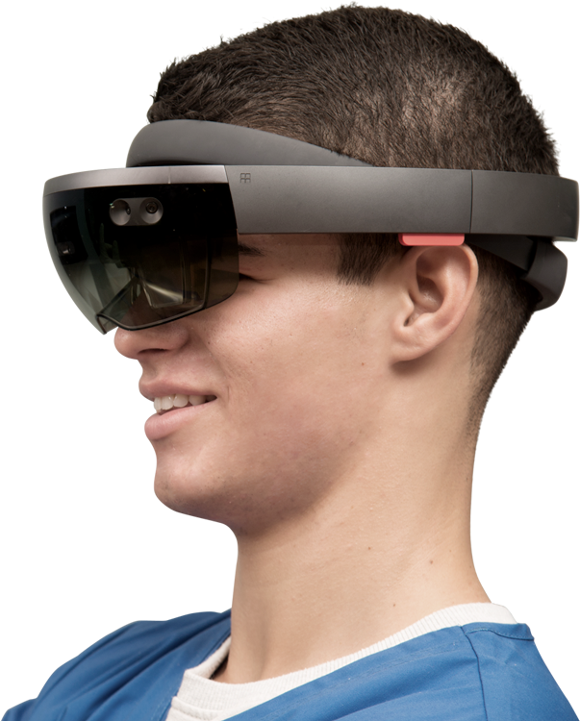
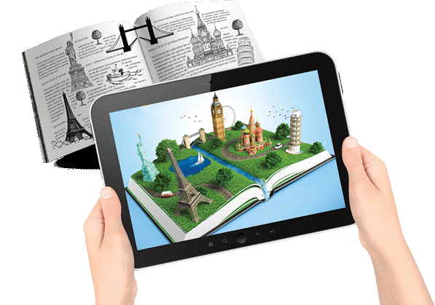
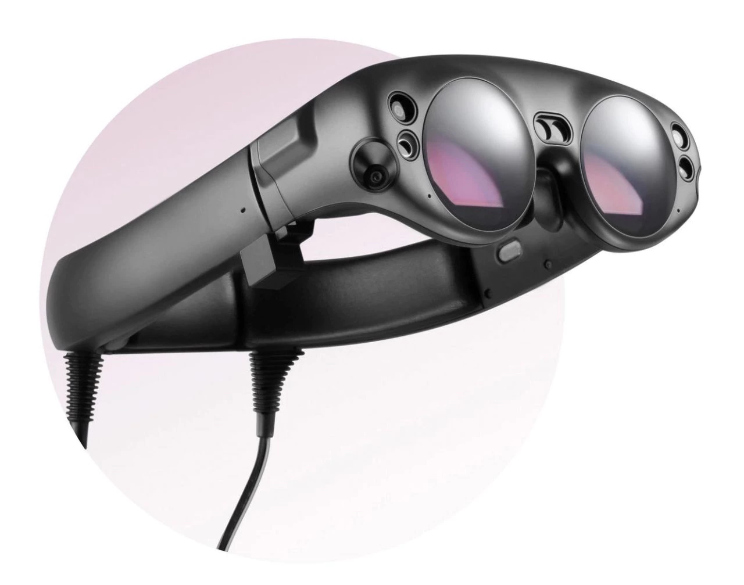
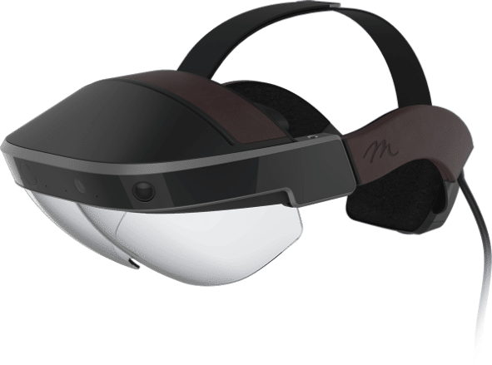




Augmented Reality
MARKER-BASED
MARKER-LESS
WIRED VISORS I
VISORS
ALL-IN-ONE
AR kit
AR Core
Microsoft HOLOLENS
Magic Leap One

Slide 16
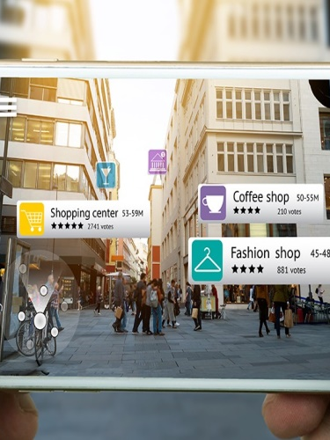
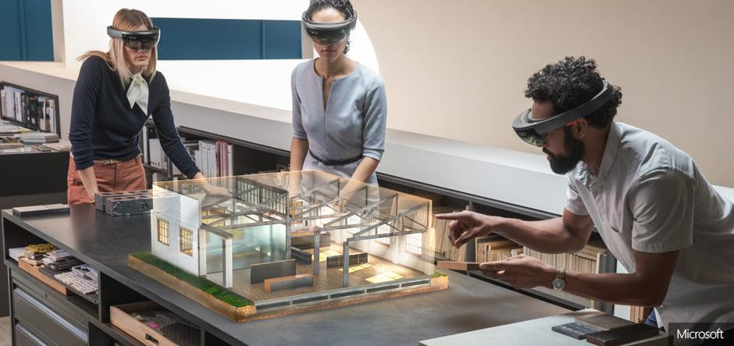
Augmented Reality
Augmented Reality
Mixed Reality
Augmented reality consists in the vision of a real environment in which some of its elements are "augmented" by digital content of various kinds
Mixed reality consists in the fusion of real and virtual world to produce new environments and visualizations in which physical and digital objects coexist and interact in real time.
Notes:
VR -> Sei tu che entri in una realtà alternativa che io ho predisposto per te
AR –> La realtà alternativa che io ho predisposto per te entra nel tuo mondo reale.

Slide 17
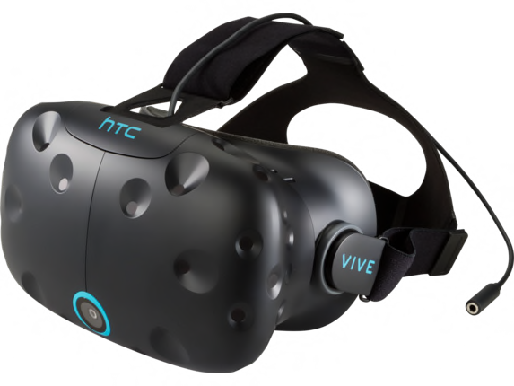
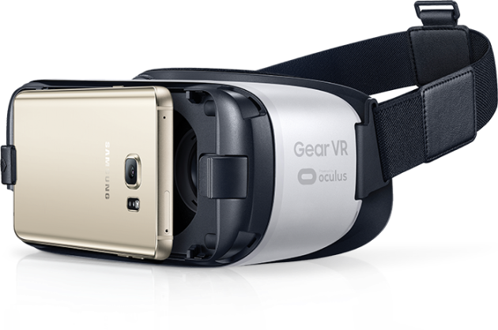
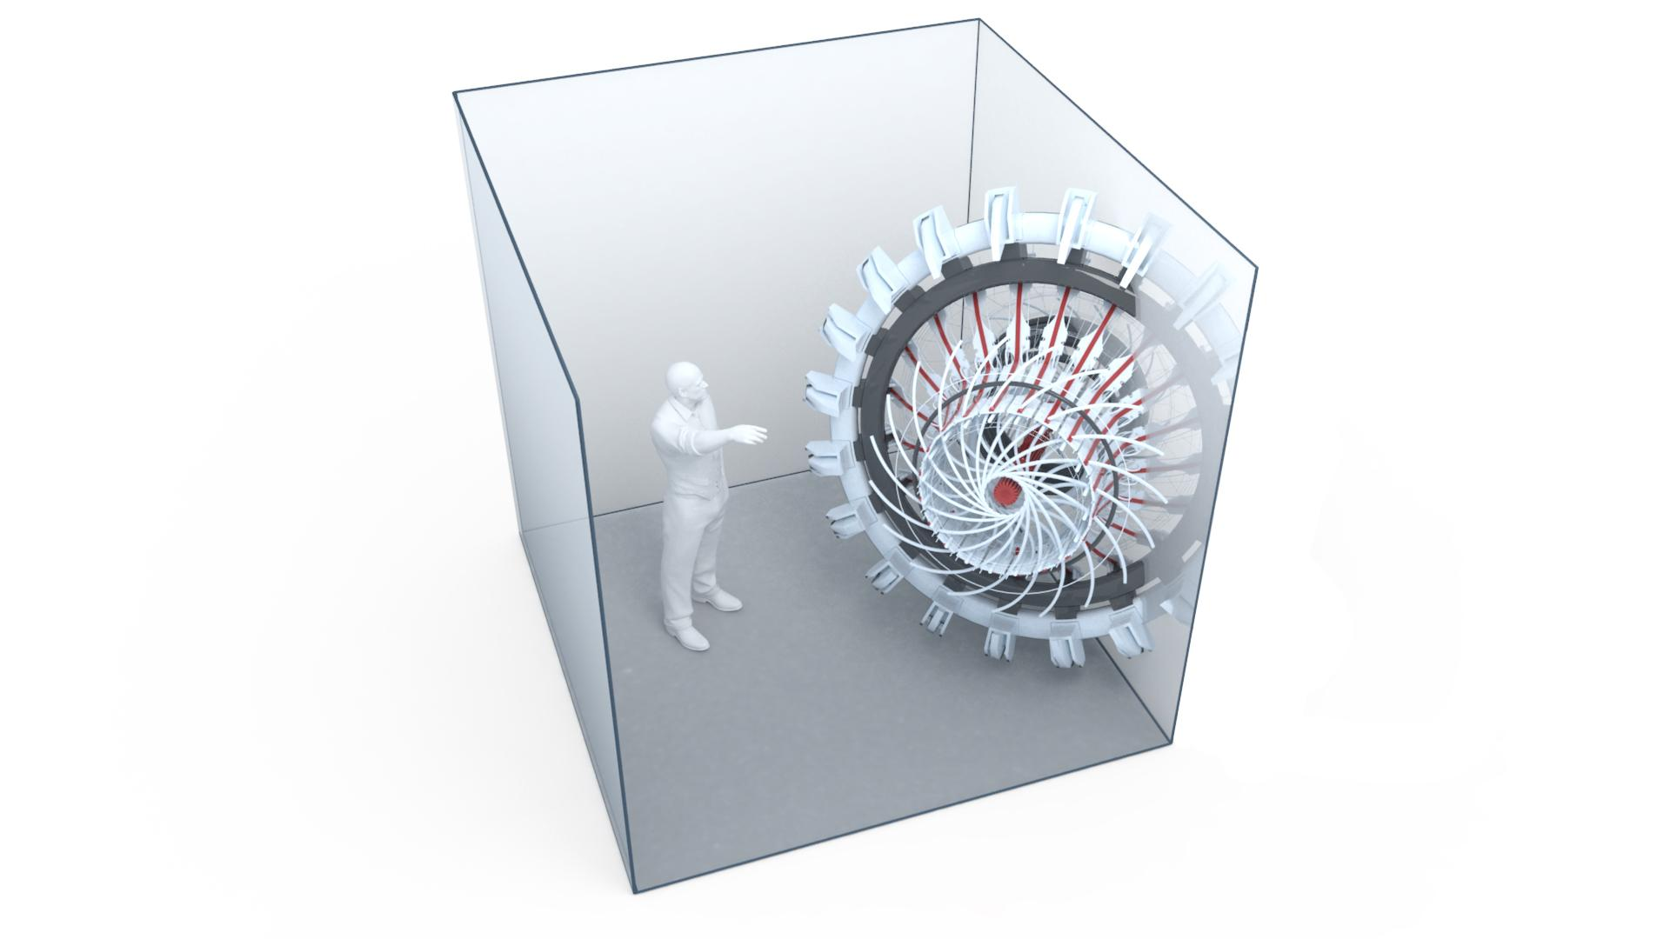
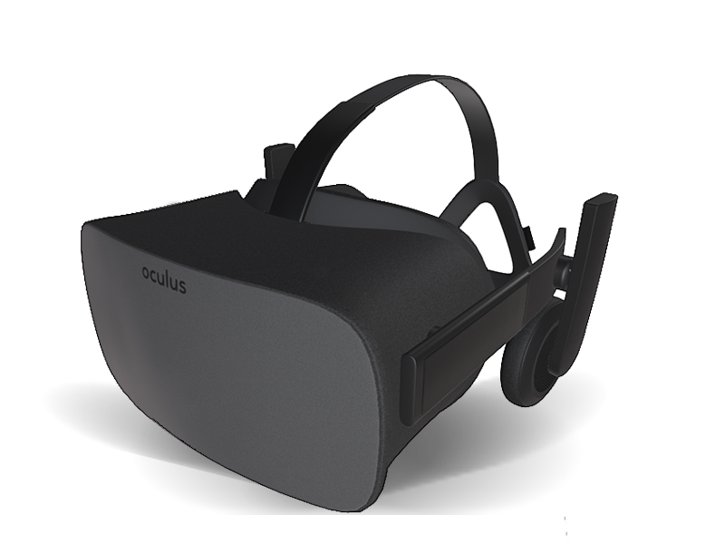
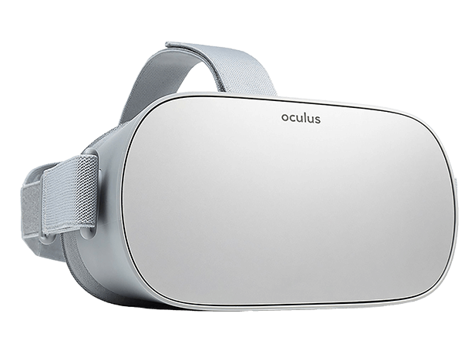
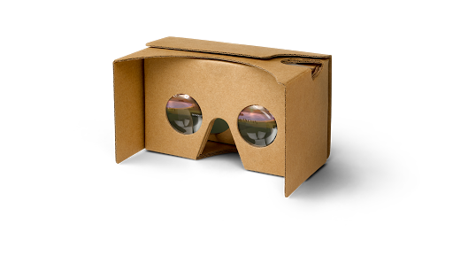
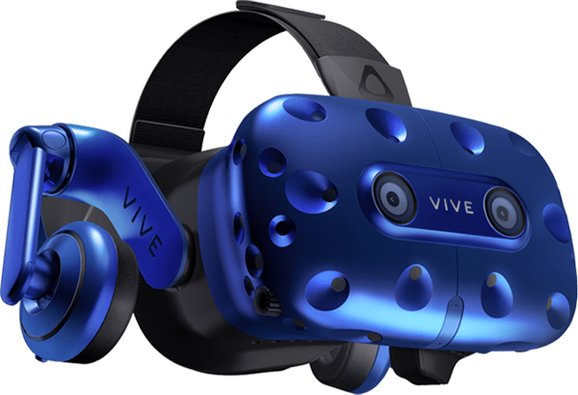
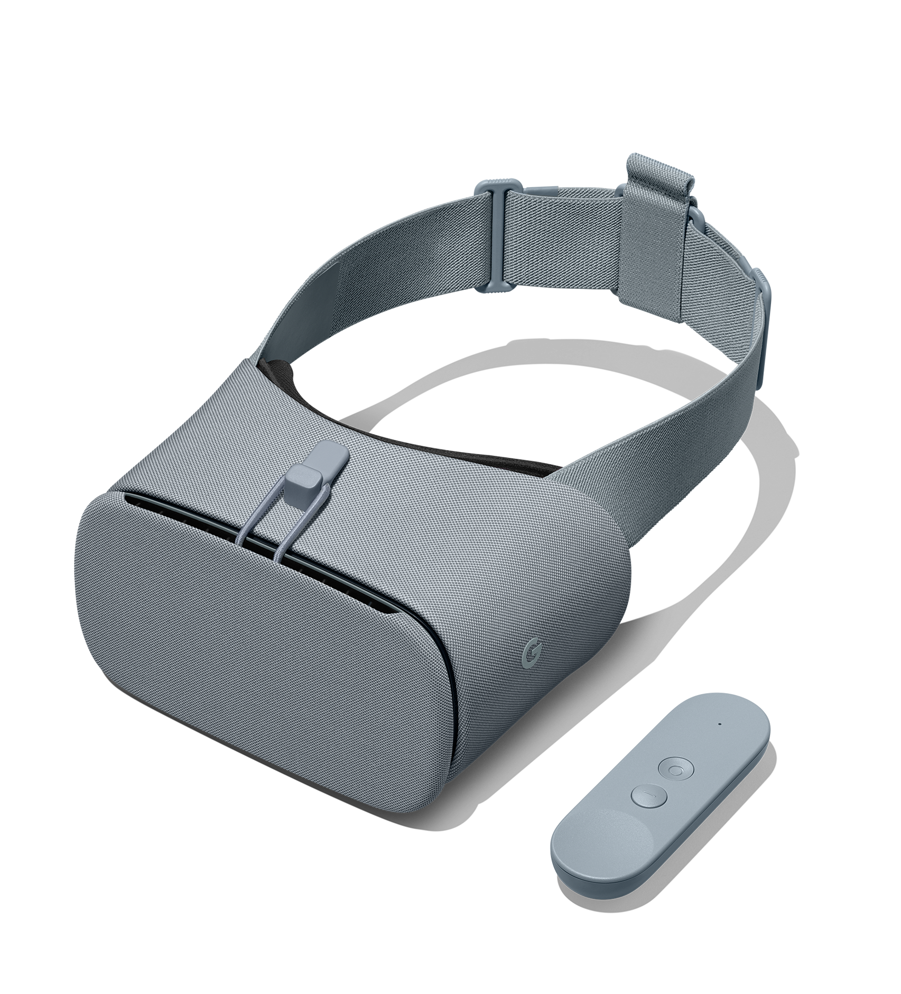
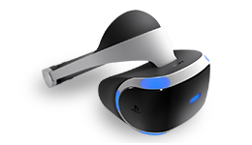
Virtual Reality
CAVE
VISORI
CABLATI
VISORI
NON CABLATI
VISORI
TUTTO-IN-UNO
VISORI
MOBILE
VISORI
CARDBOARD
Strumento professionale.
Ad 1, 2, 3 o 4 pareti.
Non esiste un prodotto commerciale ma è progettata ad hoc.
Usata principalmente in ambito ricerca.
Prodotto commerciale ma di alta qualità. Richiede un hardware esterno.
Prodotto commerciale di alta qualità. Richiede un hardware esterno.
Prodotto commerciale di alta qualità. Non richiede un hardware esterno.
Prodotto commerciale di media qualità. Richiede uno smartphone.
Prodotto di bassa qualità in genere usato come merchandising.

Slide 18
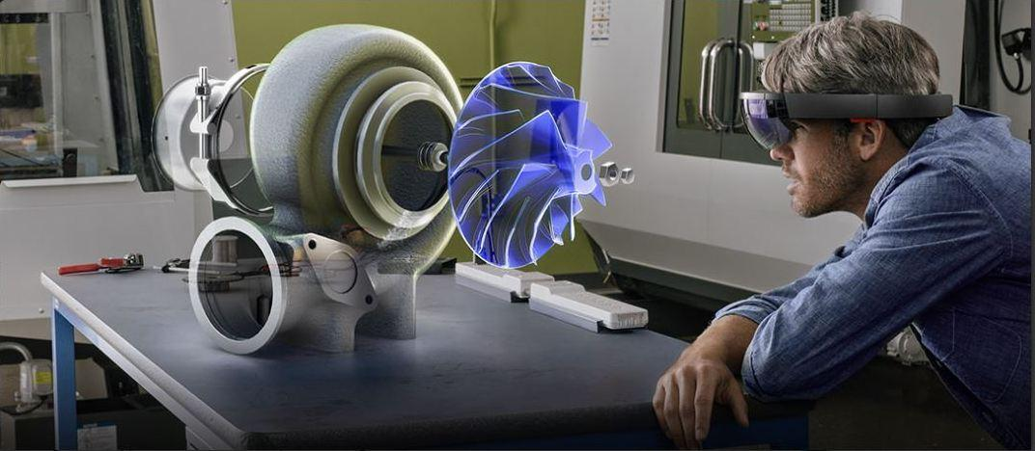
Augmented Reality (LIVE)

Slide 19
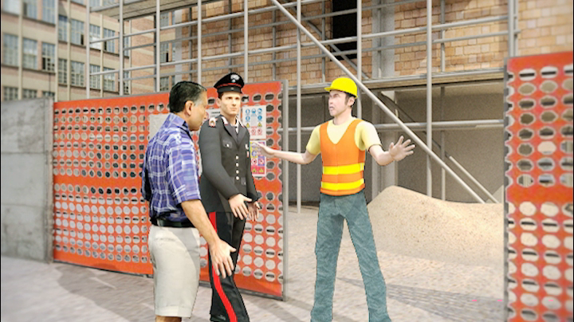
Virtual Simulation (LIVE)

Slide 20
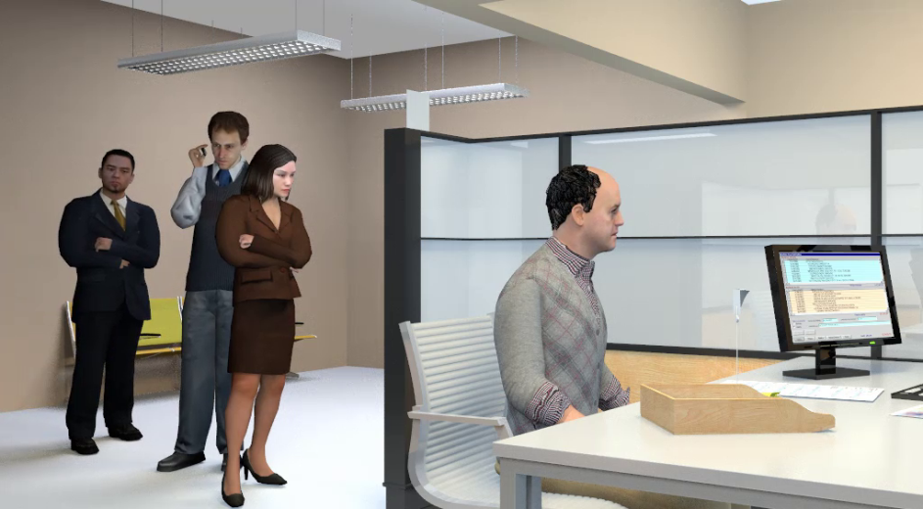
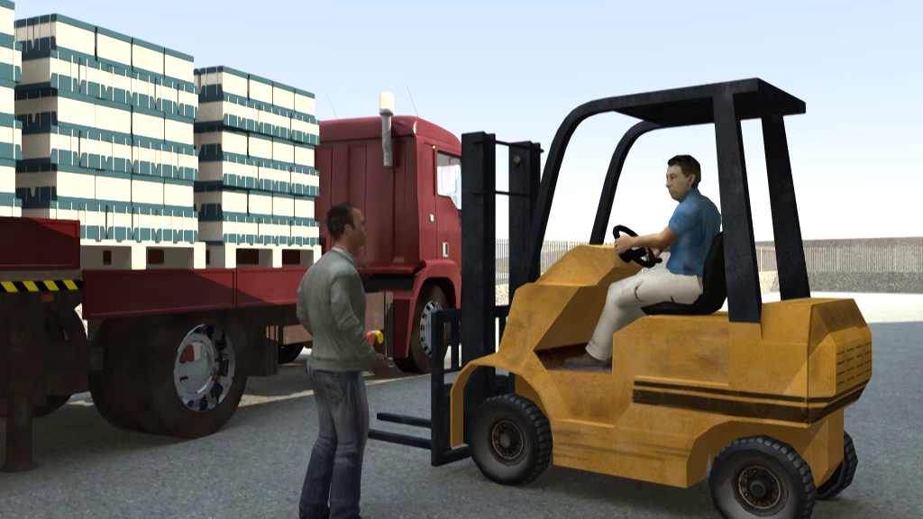
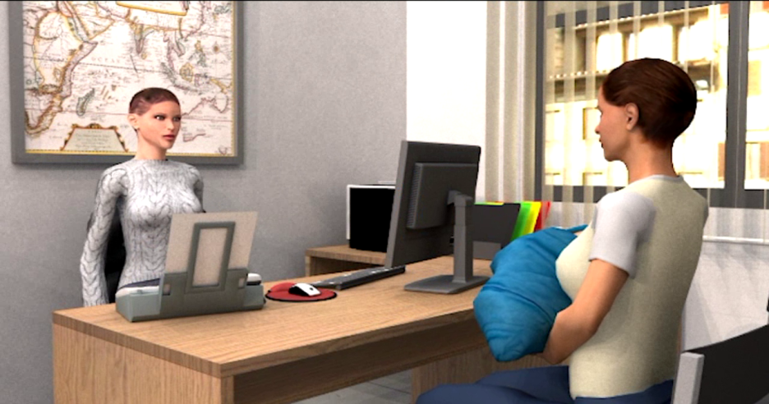

Slide 21
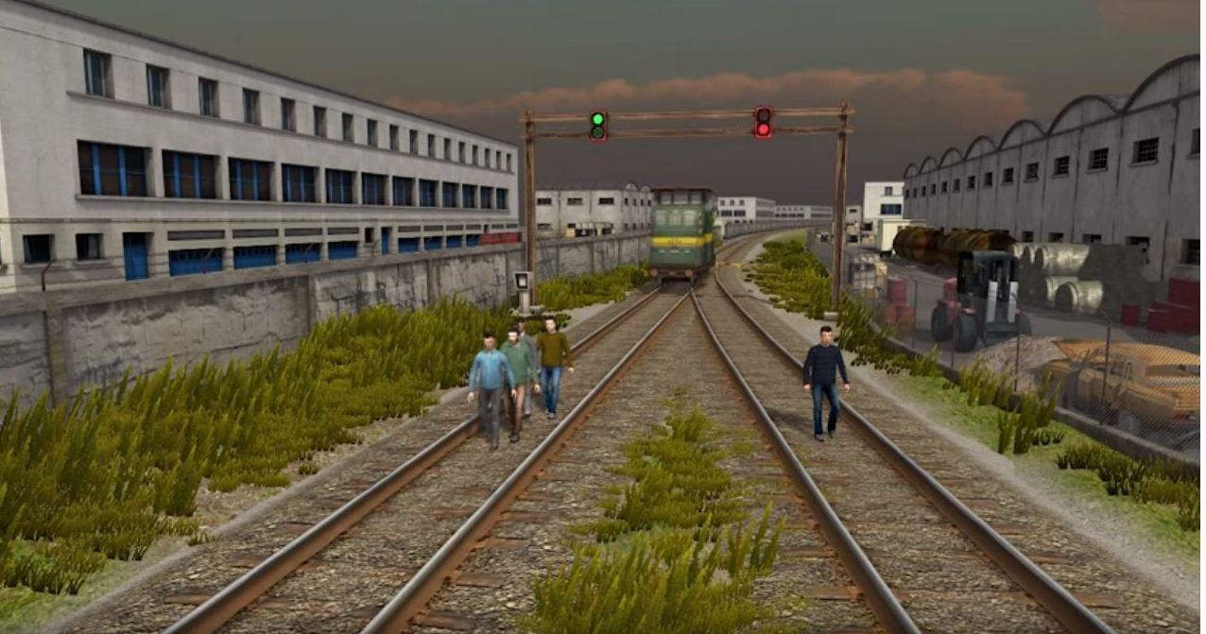
Moral dilemma(LIVE)

Slide 22
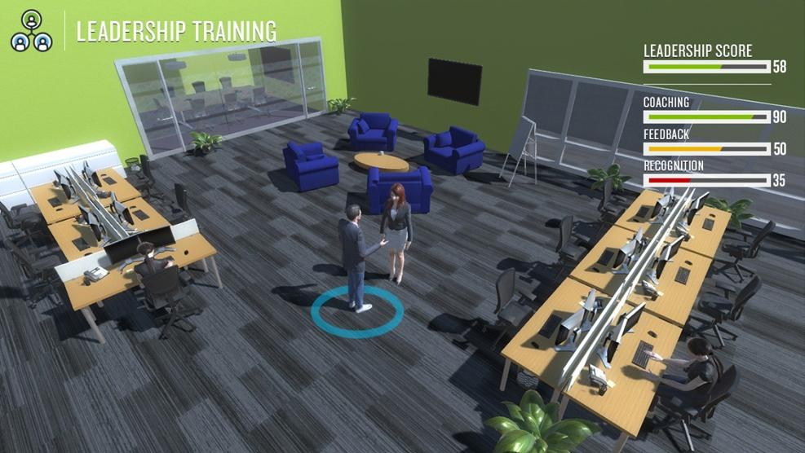
Virtual Worlds(LIVE)

Slide 23
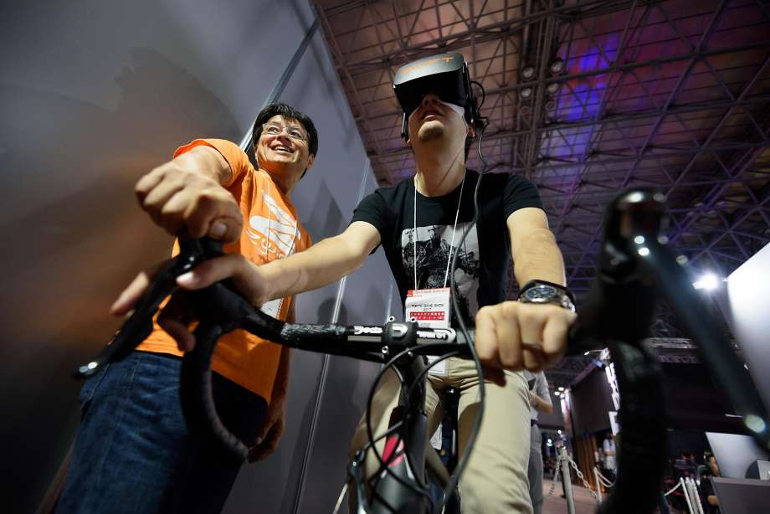
Oculus VR Headset (HIVE)

Slide 24
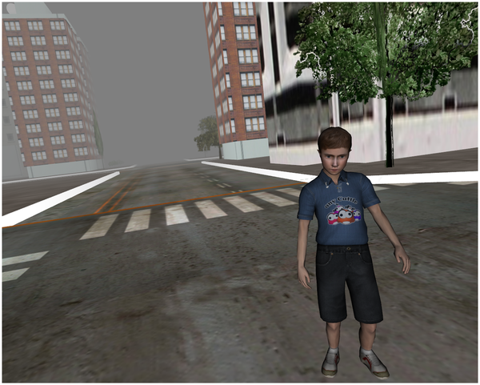
Empathy (HIVE)

Slide 25
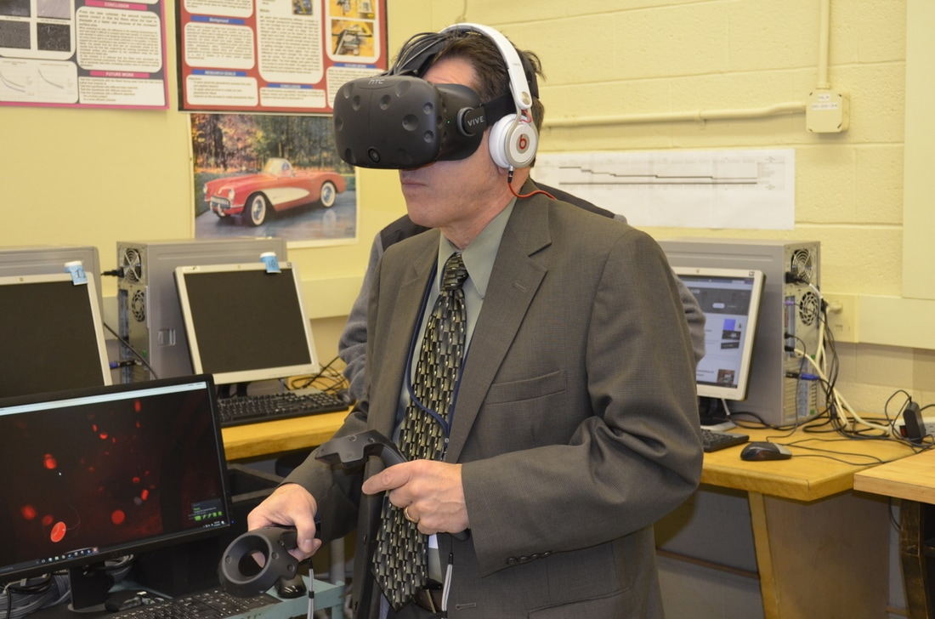
HTC Vive System (HIVE)

Slide 26
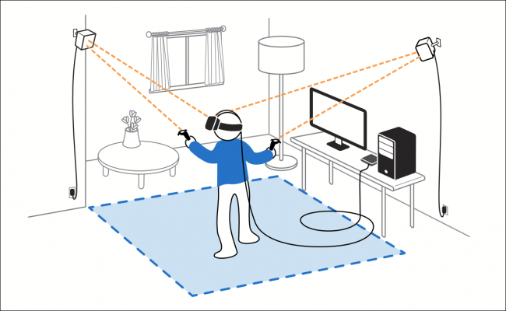
HTC Vive System (HIVE)

Slide 27
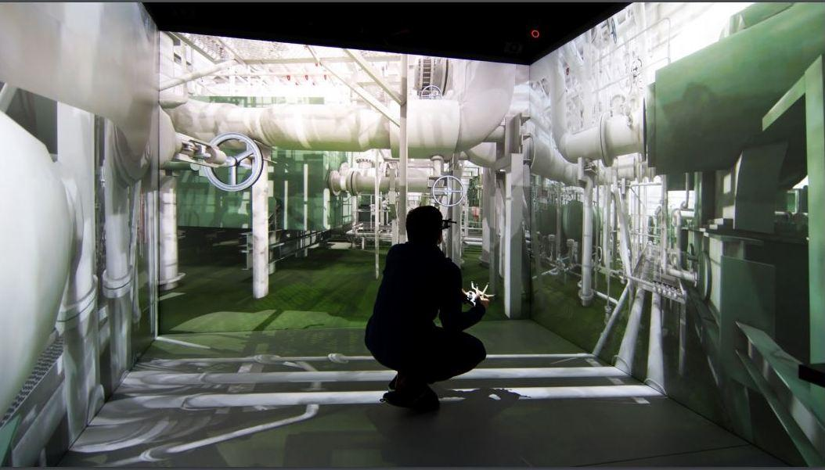
CAVE (HIVE)

Slide 28
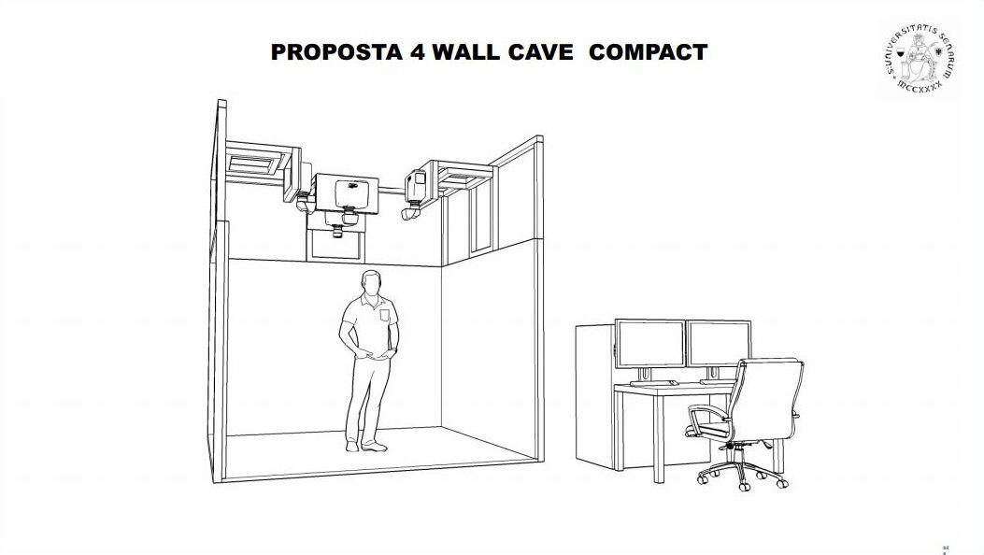
CAVE (HIVE)

Slide 29
CAVE Advantages
CAVE offers a wider field of view than Oculus Rift and HTC Vive that have a small field of view and complete isolation from the real world
CAVE allows people to be physically within the virtual environment and without a helmet
CAVE offers the possibility to interact with other individuals in artificial worlds created by the experimenter
CAVE allows you to combine images in virtual reality with real objects or people (augmented reality)

Slide 30
CAVE Experiments
Virtual Reality without HMD
https://www.youtube.com/watch?v=0V0G5M4DQfk
The CIREVE's Virtual Reality Theater (Cave) - Université de Caen Normandie
https://www.youtube.com/watch?v=_uXlg_QaFlw
Immersive Virtual Reality Technology: Experience More With EON Reality
https://www.youtube.com/watch?v=UT5xtpHRdlE
Altering Human Perception and Behavior through Immersive Virtual Reality (Microsoft research)
https://www.youtube.com/watch?v=Y-0VHEtyIR4

Slide 31
CAVE Experiments
Education
2015-16 LiveBIG: Inside Wisconsin's virtual reality CAVE
https://www.youtube.com/watch?v=mBs-OGDoPDY
Design
Architecture Virtual Reality Cave
https://www.youtube.com/watch?v=9rM7Vbh_9YA
Simulation
Simulation Cube @ Evo Philly Cira centre south VisionaiR 3D CAVE Virtual Reality system IBM
https://www.youtube.com/watch?v=b1SCT7EPaX4

Slide 32
CAVE Experiments
Management
Implementing Kanban in a Virtual Reality CAVE
https://www.youtube.com/watch?v=wompfASioZw
Social Science Experiment
Immersive Display Queuing Experiment 4
https://www.youtube.com/watch?v=-rEyKkqrKpY&t=149s
Rehabilitation
Hand Rehabilitation in CAVE Virtual Environment -Purdue University Calumet CIVS
https://www.youtube.com/watch?v=B8O2oE7WW0Q

Slide 33
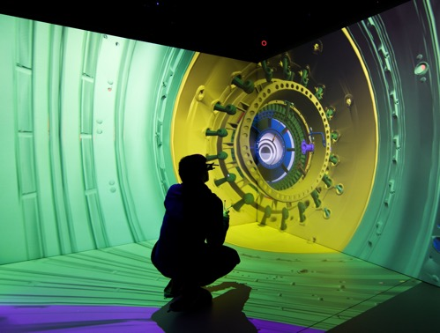
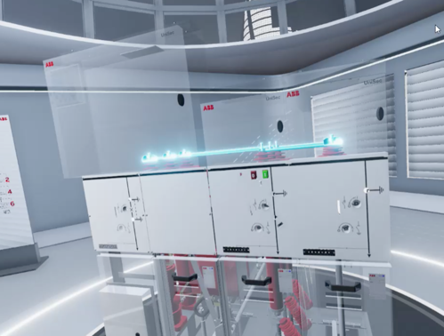

Applications
Phisical Installation
Cave
Virtual wall
VR Training
Operating instructions
Assembly
Safety
Healthcare
VR Showcase
Industrial
Product presentation
Interior Design

Slide 34
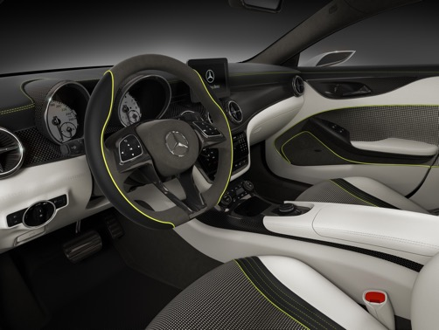
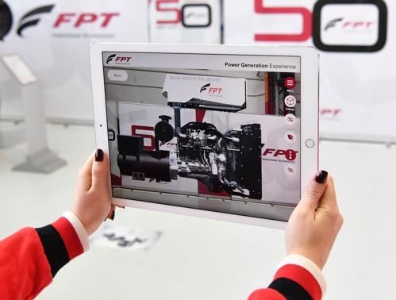
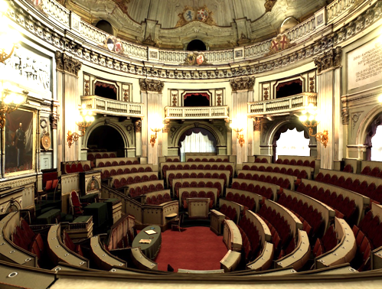
Applications
VR Design Review
Automotive
Engineering
Architectural
AR/MR Showcase
Industrial
Product presentation
Product configurator
Cultural & Heritage
Laserscan
Photogrammetry
VR Multiuser app

Slide 35
Framed field experiments
Taxonomy that differentiates natural from framed field experiments, being the latter those in which “the field context is embodied in either the commodity, the task, or information set that the subjects can use” (Harrison and List 2007: 1014).
Virtual reality experiments can be considered proper framed field experiments, since they provide contexts in which users are immersed under the control of the experimenter.
Main purpose: to verify if successful decision patterns that evolve in certain virtual reality environments travel to field and laboratory settings.

Slide 36
Key criticisms
LIVE
Anonimity
Virtual identity/avatars as a source of biased behavior
Game-like atmosphere
HIVE
Artificiality
Isolation
Presence

Slide 37
Avatars and presence
Avatar is “a perceptible digital representation whose behaviors reflect those executed typically in real time, by a specific human being” (Bailenson and Blascovich 2004)
Digital avatars are uniquely powerful in shaping how people think and behave
The media stereotype of virtual worlds as escapist fantasies distracts us from understanding these emerging communication platforms.
“being there” as “place illusion” (to distinguish it from the multiple alternative meanings that have been attributed to the term “presence”)
Slater (2009)
to describe the similar feeling that can arise when embodying a remote robotic device in a teleoperator system
Minsky (1980)

Slide 38
Proteus effect
Exp.1 Subjects having more attractive avatars exhibited increased self-disclosure and were more willing to approach opposite-gendered strangers
The attractiveness of their avatars impacted how intimate participants were willing to be with a stranger
Exp. 2 Subjects having taller avatars were more willing to make unfair splits in negotiation tasks than those who had shorter avatars
Subjects with shorter avatars were more willing to accept unfair offers than those who had taller avatars
Thus, the height of their avatars impacted how confident participants became.
Yee & Bailenson (2007)

Slide 39
Perception of presence in VR
How is it possible to build virtual environments such that people respond realistically to events within them?
People tend to respond with some level of realism to the virtual simulations and some level of presence occurs.
Ex. fire: another participant covered her eyes, and stepped back away from the fire, some reported feeling heat, and even smelling the smoke.
One way to think about the goal of presence in research is that to be successful it should be able to discover what would be necessary to make people actually and physically run away from a virtual fire (Slater)

Slide 40
VR presence depends on clues
The key points are determined by our prior model of what a room is. We have “seen” a small proportion of what there is to see; yet, our perceptual system has inferred a full model of the room in which we are located. In fact it has been argued that our model of the scene around us tends to drive our eye movements rather than eye movements leading to our perceptual model of the scene (Chernyak and Stark, 2001).
VR works whan it offers enough cues for our perceptual system to hypothesize “this is a room” and then based on an existing internal model infer a model of this particular room using a perceptual fill-in mechanism (Stark 1995)

Slide 41
Effective sensory substitution
If sensory perceptions are indeed effectively substituted
then the brain has no alternative but to infer its perceptual
model from its actual stream of sensory data – i.e., the VR.
Hence, consciousness is transformed to consciousness of the virtual scenario rather than the real one – in spite of the participant’s sure knowledge that this is not real.
By an immersive VR system we mean one that delivers the
ability to perceive through natural sensorimotor contingencies

Slide 42
Food for thought
There are two components of presence : PI (resting as a necessary condition on sensorimotor contingencies) and Psi (the illusion that events are real) (Slater and Sanchez-Vives 2016)
Virtual Reality encompasses virtual unreality
There is no need of realism or perfect digital rendering
Immersion is an automatically induced state

Slide 43
3. LIVE Experiments
LIVE Experiment 1
To test differences of physiological activations in subjects watching real movies vs. virtual movies
LIVE Experiment 2
Individual risk attitude under social exposure in the lab is modified by the presence of a virtual coach

Slide 44
LIVE Experiment 1
Ob.: to verify the presence of differences in the physiological and cognitive activations while subjects watch video clips vs. virtual movies
Hp.: Exposure to video clips is associated with greater physiological activations than exposure to virtual videos.
Ts.: By inducing less emotional involvement, exposure to low immersive virtual environments may trigger cognitive restructuring mechanisms of stress perception and enhance the ability of removing heuristics and biases commonly activated in real life.

Slide 45
Design
Between-subject experiment
18 undergraduate students
2 Conditions: Real clip of a job stress situation + Virtual simulation of the same situation
Detection of physiological indices during three short extracts;
Heart rate - Electromyography (EMG), i.e. electrical impulses of face muscles at rest and during contraction -Skin Conductance Level - Eye-tracking
Questionnaire:
Generalized Self-Efficacy - Locus of Control - Questions on emotional states

Slide 46
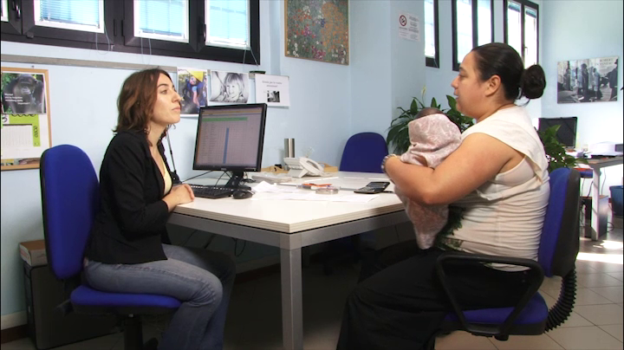
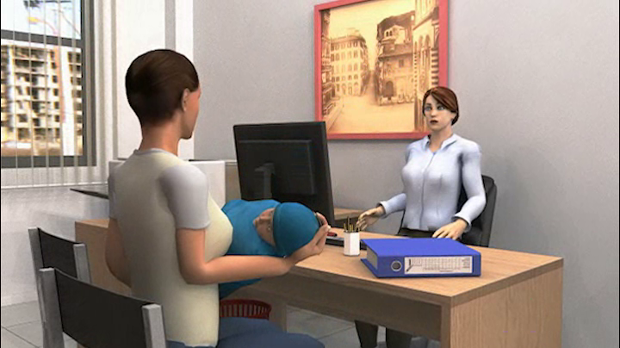
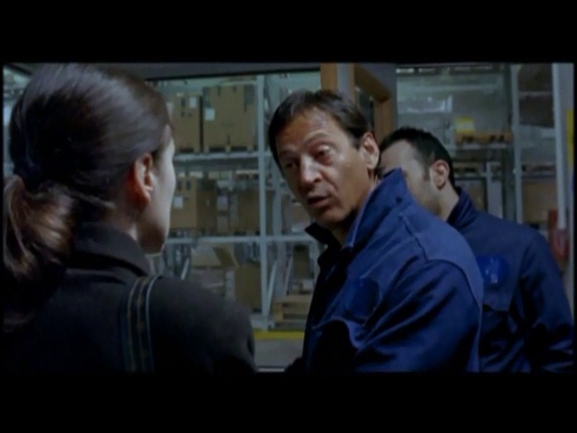
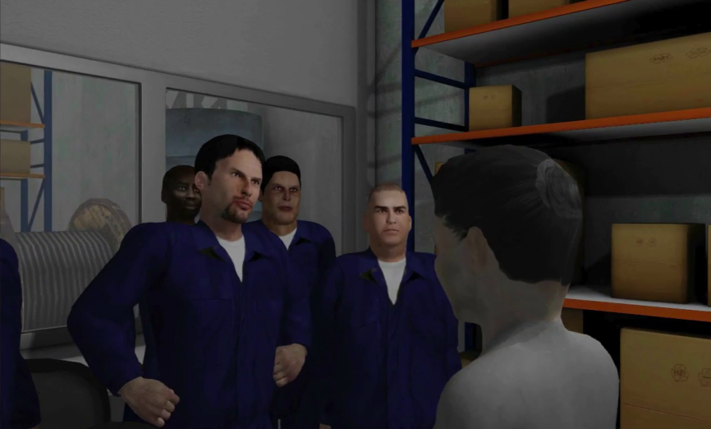
Materials

Slide 47
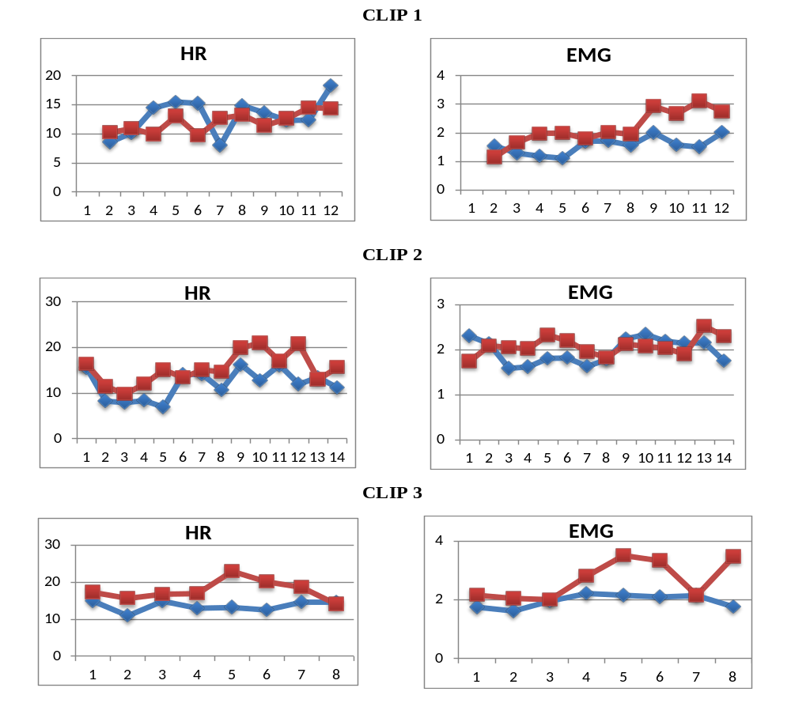

Slide 48
Findings
Participants experienced greater physiological arousal during the exposure to real videos than to virtual videos
Findings can be ascribed to the type of visual representation and not to individual differences in the attribution of emotional content to the videos, not detected by the self-report questionnaires
Participants experienced a lower level of anxiety due to the weaker sense of presence caused by low immersive virtual environments

Slide 49
LIVE Experiment 2
Risk-taking with virtual coach (Faralla et al. 2013)
choice between safe and risky option
two tasks: rare-loss and equiprobable-loss
exposure vs. no-exposure condition
observer vs. source role
Main finding: Observing others’ choices increases observer’s risk propensity

Slide 50
Design
Between-subject
52 undergraduate students
Two subjects randomly and anonymously paired playing as source and observer
30 repeated choices (alternate):
15 rare (equiprobable) gains
15 rare (equiprobale) losses
Comparison between source and observer condition

Slide 51
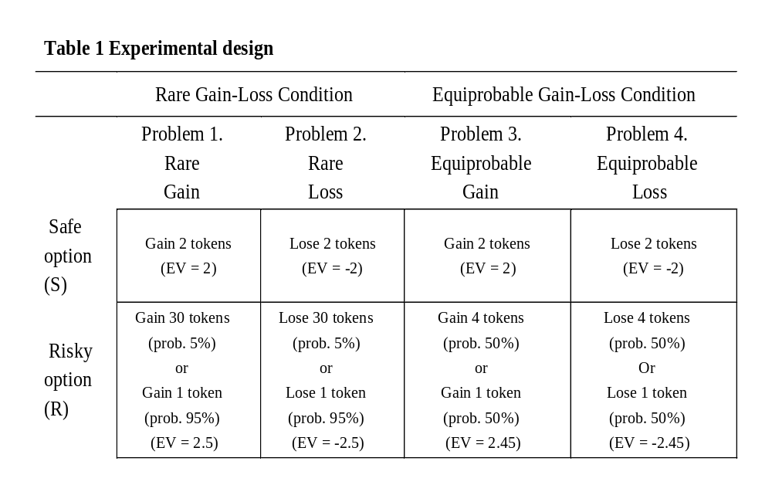
Tasks

Slide 52
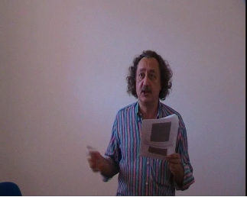
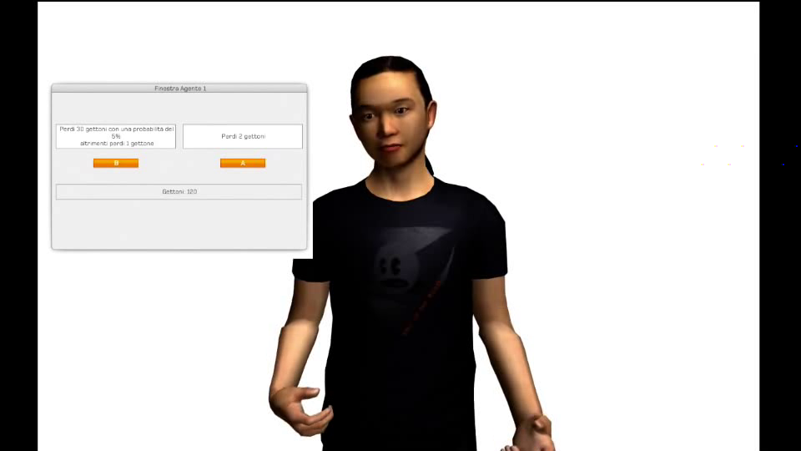
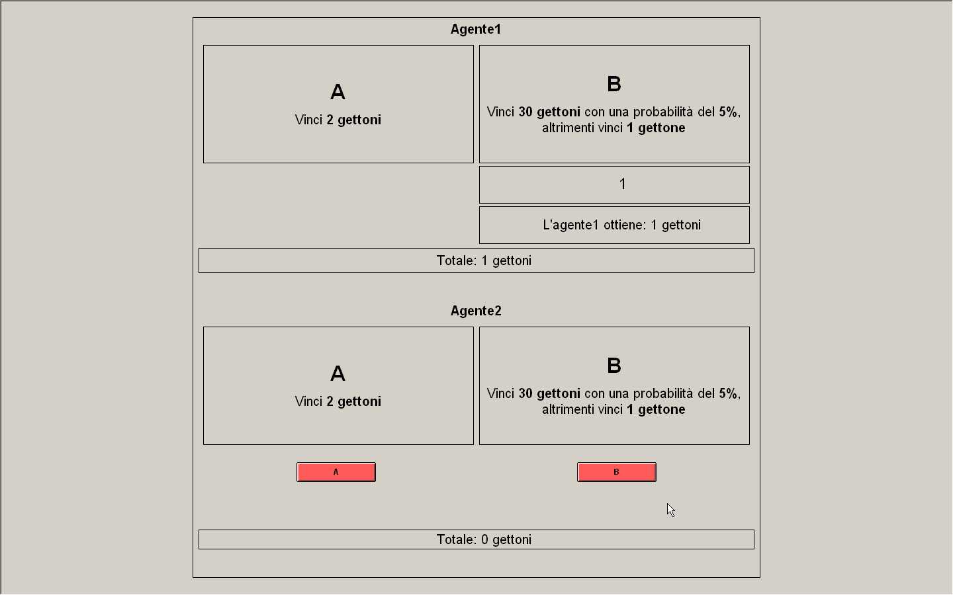
LIVExp 2 - Design

Slide 53
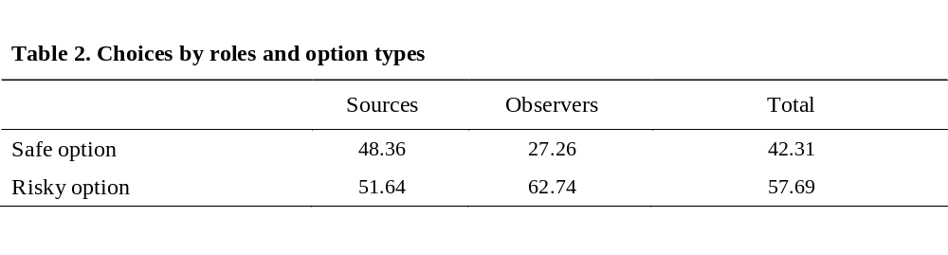
Findings (no virtual coach)
Observers are more risk-takers than sources for both gains and losses
Both roles are risk averse for losses and risk loving for gains
No significant difference between rare/equiprobable condition
Faster reaction time for sources

Slide 54

Findings (virtual coach)
No significant differences in risk attitudes between observers and sources
Both roles are confirmed as risk averse for losses and risk loving for gains
No difference in reaction time across roles

Slide 55
Interpretation
Differences between observers and sources are removed because the virtual coach make subjects’ choices less influenced by laboratory cues
Laboratory with virtual coach is perceived as an intermediate safe environment
The Proteus Effect / deindividuation occurs in online environments because users may adhere to identities inferred from their avatars
The presence of virtual coach allows structuring therapy like a protected environment

Slide 56
4. What future? A modest approach
Main Approach to LIVE: to test if subjects’ behaviour in VE conforms to results of conventional experimentation
“Virtual experiments might be more convenient than lab experiments if he sees people behave in the same way in real-world and virtual experiments” (List 2007)
“Determining where virtual world behavior mimics real world behavior is quite important for methodological reasons.” (Castronova 2008)
But the difference between virtual and laboratory experiments and between virtual and real behavior is an asset rather than a problem for experimental economics.

Slide 57
The pros of VR
Providing more context and less simple settings
No involuntary non-verbal communication (avatars)
Wider and heterogeneous subjects pool (virtual worlds - LIVE)
Tool for detecting cognitive biases and for nudging
Simulations of intertemporal choice

Slide 58
The cons of VR
Virtual situations project a game-like atmosphere
Proteus effect / deindividuation (also an asset)
It is difficult to establish subjects’ trust in computers
Subjects’ identity cannot be checked (virtual worlds)

Slide 59
LIVE for nudging
LIVE are appropriate to test how individuals adjust the decision pattern adopted in real settings and how they modify behavior, because the weaker sense of presence enhances mental readiness and facilitate the objectivity in evaluating virtual scenarios while partially weakening the effect of cognitive biases
In this perspective, a promising field of application of virtual reality experiments concerns the efficacy of empirical nudges, as behavioral change interventions aimed at influencing choices by making use of flaws in individual decision-making.
The same approach can be applied to study experimentally intertemporal choice.

Slide 60
HIVE for eliciting biases
HIVE can provide better evidence on how individuals react in risky situations or how misperceptions are formed
Full immersion is more appropriate to detect which types of context activate automatic and unconscious decision patterns
The deep sense of immersion, which conveys the feeling of being here, makes individuals experience emotional engagement and adopt the heuristically driven behavior induced by the experimental cues before they consciously reason out the situation

Slide 61
The best approach?
The preferable approach to turn the novelty of virtual reality into an actual tool is to be unpretentious
It is probably a mistake to use VR to build the bridge between the field and the lab
It is also to assume that participants behave in VR as they would do in similar circumstances in reality
The difference between virtual and laboratory experiments and between virtual and real behavior may be an asset rather than a problem for experimental economics.

Slide 62
How VR in economics?
The same modesty of the early years of experimental economics
Internal validity vs. external validity
Smith’s and Plott’s market games (external validity)
Game theory provided models easily testable in the lab to check if behavioral implications of these models fit what happens in the real world (internal validity)
Which model is better for VR experiments in economic experiments?

Slide 63
Ongoing Projects
Risky Decision Making
Intertemporal Choice
Training on Hazardous Tasks
Maintenance and assembly of pharmaceutical industry equipment (CAMI s.r.l., Pharma Integration TLS)
Safety courses for construction industry
Education
Childhood and secondary school (Safe Play Game and Nudging)
Museums (Siena Museum Systems)
Food and education (Santa Chiara Lab Unisi)

Slide 64
Bibliography
Bainbridge, W. S. (2007). “The scientific research potential of virtual worlds.” Science 317, 472–476.
Harrison, G. W., E. Haruvy, and E. E. Rutström. (2011) “Remarks on Virtual World and Virtual Reality Experiments.” Southern Economic Journal 78, 87–94.
Innocenti, A. (2017) “Virtual Reality Experiments in Economics.” Journal of Behavioral and Experimental Economics 69, 71-77.
Rosenberg R.S., S. L. Baughman S.L., and J. N. Bailenson (2013) “Virtual Superheroes: Using Superpowers in Virtual Reality to Encourage Prosocial Behavior.” PLoS ONE 8(1).
Laboratory of Virtual Reality and Economic Behavior
https://lavrebweb.wordpress.com/
Blog LabVR https://paper.li/e-1545258725#/
Twitter LabVR https://twitter.com/alessandroinn18

